Slide 1
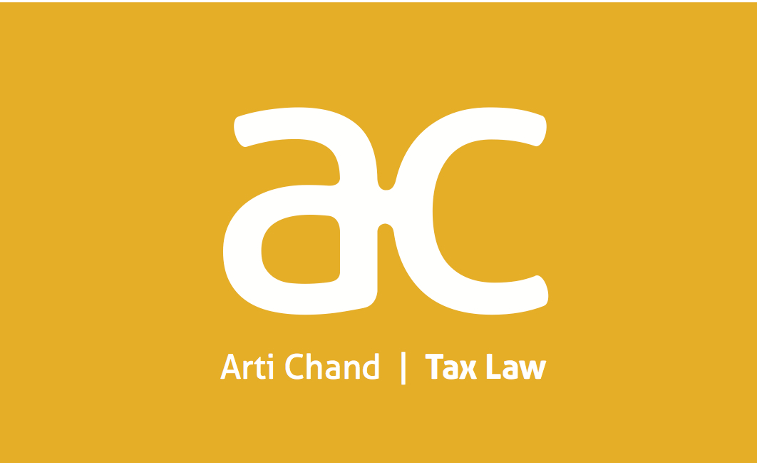
Future of Charities & Tax
Business Income Exemption
Arti Chand
arti@actaxlaw.nz
www.actaxlaw.nz
+64 21 922 718

Slide 2
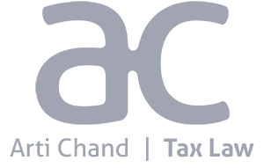
Charities: business income
Income derived directly or indirectly from a business carried on for:
a trust/society/institution established and maintained exclusively for charitable purposes and not for the private pecuniary purpose of any individual; and
the trust/society/institution is a tax charity; and
it is carrying out charitable purposes in NZ; and
controlling persons cannot direct/divert income to the benefit of anyone other than the charity
The business must be carried on for charitable purposes.

Slide 3
Charities: business income
Why would a charity use this exemption?
Funding - need to develop self sufficiency
Provide services/products at lower than market
Need to partner with commercially driven organisations - on projects that ultimately will further the charitable purpose

Slide 4
Charities: business income
30% of charities have trading activities in NZ (TWG). For example:
Commercial property investment;
Residential rental property investment;
Shops (Op shops, discount shops);
Retirement villages;
Farming

Slide 5
Charities: business income
What amendments/changes are happening now:
Trading entity must now also be a registered charity - amendment application from 1 April 2019. Enacted 18 March 2019.
Tax Working Group
Exemption to apply only to the extent the business income is used for charitable purposes;
What about accumulation for necessary reasons?
Is the exemption “wrong” - providing an unfair advantage to charities in the commercial sphere?

Slide 6
Charities: business income
What is the future?
Fundraising/funding issues necessitates commercial trading options;
Australia - retained the concession (Henry Report)
Other jurisdictions - focus on “related” business, and accumulation of profits
In NZ, Charities Services will register fundraising entities as charities.
What other changes should we expect?

